Slide 1
Run-down of DRC
The mission: We assist refugees and displaced, protect their rights and empower them towards a better future
DRC is the largest Danish NGO and leading international NGO working with displaced people
DRC is present in more than 40 countries with extensive humanitarian programs. From the moment you flee the conflict until you are settled and ready to start a new life, DRC is with you
Our programs cover humanitarian relief (water, food, medicine, warm clothes), shelters, peacebuilding & protection, legal aid, self-reliance programs, sustainability and climate change projects as well as educational programs. DRC cover the full refugee-cycle.
DRC is ranked as no 4th best NGO in the world
DRC Strategy 2025 as current strategic marker for our programmes and projects
Notes:
By Strategy 2025 DRC intensifies its fight against systemic inequality and structural discrimination against conflict and displacement affected persons.
Increased protection
EQUAL TO OTHERS: People affected by conflict and displacement must be able to seek safety and claim basic rights.
Enhanced inclusion
ON PAR WITH OTHERS: People affected by conflict and displacement must be able to pursue self-reliance.

Slide 2
ABOUT PIBE (Programme Innovation & Business Engagement)
Innovative Financing & New Business Models
Tools
Climate and Environment
Go Digital and Predictive Analytics
Youth Empowerment and Participation
Business Engagement & Shared Value Partnerships
Learning, Innovation Toolbox & Partnership
Notes:
Fostering Program Innovation, Business Engagement, New Partnerships & Innovation Methodologies
What - Frame: The Program Innovation and Business Engagement (PIBE) Unit
PIBE drives and supports program innovation and new business engagement across DRC to fulfil DRC’s mission and strategic objectives.
Overall objectives are to ensure that i. DRC’s organization, staff and response is informed by-, enabled by- and contributes to new innovations in the humanitarian sector and beyond, and ii. new partnerships that support innovation are developed.
We work through thematic organization, leading innovation within selected themes aligned with strategy, and supports the wider organization to engage in innovative partnerships and adopt innovation methodologies in our approach to programming and problem solving.
What – thematic areas
Innovative Financing and New Business Models - By 2025, Innovative financing initiatives in DRC has shown a year-on-year increase from 2022, and innovative financing initiatives have directly contributed to realizing the ambitions of the two Breakthroughs, and at least two Strategic Priority Initiatives and two Organisational Principles of Strategy 2025.
Climate and Environment (Go Green) -By 2025, DRC responds strategically to climate change and environmental degradation across the organization, realizing the ambitions of DRC’s Climate and Environment Framework and our Climate and Environmental Performance targets
Innovation Toolbox and Partnerships By 2025, innovation methodologies and digital programming approaches are systematically employed across DRC. DRC bridges the gap between global and local innovation and mobilizes new partners – with the annual DRC Global Innovation Event as the key reference point for the organization
Business Engagement and Shared Value Partnerships - By 2025, Shared value private sector partnerships contribute to key components of DRC’s program ambitions in Strategy 2025. Business Engagement is an embedded practice across DRC regions and country operations and DRC staff and entities have access to and use relevant tools to engage in business partnerships
Youth Empowerment and Participation - By 2025, DRC has a leading, global position on facilitating meaningful engagement and participation of young people affected by displacement towards increased protection and enhanced inclusion in pathways to self-reliance.
Go Digital and Predictive Analytics
Who - HQ team
Morten – lead; Nana – Innovation and Partner Specialist (Business Engagement) – RIL Executive Committee member; Jakob – Youth Engagement; Lillah – Climate Advisor; Sacha – Innovative Finance Advisor; Rogers – Mitigation Specialist (EAGL/Kampala); Letty – Prog. Innovation and Innovative Finance ME expert; Alistair - Prog. Innovation and Innovative Finance EAGL expert; Xx – Adaptation Specialist
Student assistance: Climate & Youth
To be onboarded: Refugee investment staff; RIL and programme innovation support coordinator EAGL
Examples
Fair Recycling https://www.google.com/imgres?imgurl=https%3A%2F%2Fi.vimeocdn.com%2Fvideo%2F1379131302-882715201c62f6ba94926b7d3c04bb1a4ba710c20b1de97cbd08e3bf9a51fef0-d_640&tbnid=cdfhXFLI6dIqkM&vet=12ahUKEwj70uOa2Or-AhUQuaQKHU5wD-AQMygEegQIARAt..i&imgrefurl=https%3A%2F%2Fdanida-business-partnerships.dk%2Fprojects%2Ffair-recycling-an-inclusive-and-formalised-plastic-recycling-ecosystem-in-kenya%2F&docid=42FywBB21AZU0M&w=640&h=360&q=fair%20recycling%20dMDP&ved=2ahUKEwj70uOa2Or-AhUQuaQKHU5wD-AQMygEegQIARAt
RIF: https://www.refugeeinvestmentfacility.net/

Slide 3
RIL Pitch: Global Local: Tools/methodology sourcing, sharing lessons learned, go local
D
R
I
L
C
Traction: Demand for locally-led, sustainability, stronger methodology and tools to assist and power programme innovation from fellow DRCers
DRC’s Strategy 2025 focus on enhancing conflict and climate resilience among people affected by displacement – sustainability (‘Go Green’ and ‘Go Local’)
Communities have shown incredible ability to adapt to changing contexts and situations
G
Focus/Outcomes: Tools/methodology co-creation and capacity development within DRC and with partners and as we work more and better localized
O
L
B
L
O
C
A
L
L

Slide 4
RIL Pitch: Community-led Climate adaptation approaches/projects in South Sudan and Somalia
D
R
I
L
C
Traction: Base-up climate adaptation in humanitarian contexts (DRC Global Inn. Forum ‘23
Challenge: Limited understanding of how an NGO such as DRC might better support community-level innovations around climate adaptation meaningfully
Aims
DRC in a facilitative role with RIL partners, working better with the local ecosystems and communities to develop and scale those solutions that are grown in communities, meeting real-life challenges that increasingly occur in the face of climate change.
Bringing key actors together in the local settings, demand-based
Partnering with experienced actors to develop approaches, tools, and/or frameworks to support and boost community-level based innovations for climate adaptation
G
Envisioned Outcomes
Understand community solutions and decision structures for gradual or radical adaptations and documentation of climate adaptation innovation works by communities
Develop a model or approach that can be relevant in multiple contexts as community-led
Support acceleration via challenge funds
O
L
B
L
O
C
A
L
L

Slide 5
Back up

Slide 6
PIBE Portfolio - Examples
Scoping and Field-led pilot initiatives
Flagship project on Youth Empowerment in Jordan
Refugee Investment Fund
Carbon Financing exploration
Growing climate portfolio
Machine Learning: Foresight Displacement Forecast
Global Convenings: Global Innovation Forum
Learning and Programme Innovation tools and methodology provider
Notes:
PIBE Flex funds: Supporting new ideas, picking up new trends, innovative opportunities across field-led offices
(Digitalization, Social Media listening, Climate adaptation, Social Enterprise collaborations, Forest cover monitoring - Satellite imagery)
RYSE: Supporting 25,000 Syrian and host community youth in Jordan to become agents for change. The project is adapting the Graduation Approach to the displacement context and engages government, the private sector and investors
RIF: Provide investments and technical assistance to local companies in displacement contexts to increase employment and employability, support better access to goods and services and enhance financial inclusion. An innovative refugee impact investment collaboration between DRC and iGravity, offering longer term, holistic financing solutions for increased refugee impact.​ The pilot fund for Jordan and Uganda runs for 5 years, with investments and technical assistance allocations expected to be made within first 24 months, with all investments closed (loans repaid) within a 5-year period. The RIF is financed by a mix of grant donors and impact investors​
Go Green/Climate:
Go Green Masterclass
Greening Month
Strategy Adaption - Mitigation - Advocacy
GO Green Talks Series
NEAT screening tool
COP involvement
Go Green Flex Funds Pilot Projects
Carbon credit

Slide 7
Funding pitch
Calendar year budget commitments (2023)
Core RIL support e.g.
Communication, staff and methodology development (online)
Engagement/Exchange/knowledge share opportunities with RIL members
Project funds (RIL; DRC CO in South Sudan, Somalia and EAGL RO)
Challenge mapping, Ecosystems mapping and engagement, workshops, challenge funds`
DRC EAGL based RIL coordinator (LoE 50%) – 18 months
Notes:
Core 2023 RIL, Coms, Development of new Challenge Mapping workshop/ training materials – knowledge exchanges: $10.188
Somalia Ecosystem Mapping /Challenge Mapping / Convener events/ Seed funds : $31.820
South Sudan Ecosystem Mapping / Challenge Mapping / Convener events / Seed Funds: $42.200
DRC EAGL coordinator (2023) $12.000
=between 90.00/100.00 USD (2023/2024)

Slide 8
Pointers for next steps
RIL check list / procedural requirements (enlighten us☺)
DRC vetting procedure (getting your approval to go ahead?)
Finalize / confirm budget figures
Plan announcement (during RIL X Event?)
RIL X Event (very excited to join you!)
Internal kick of call with Somalia; South Sudan
Advertise EAGL coordinator position
Engagement questions
How can DRC be value add partner/ensure complementarity?
Any ideas/Inspiration very welcome ☺
Ideas on community-led challenge funds for climate adaptation accelerator!
EAGL engagement (week after RIL x) – your or regional peers interested to sit down?
And your reflections/ questions ☺

Slide 9
What we do
DRC’s 5 global programmatic focus areas
Economic recovery & educational programs
Shelter & settlements
Humanitarian disarmament and peace building
Camp coordination & camp management
Protection

Slide 10
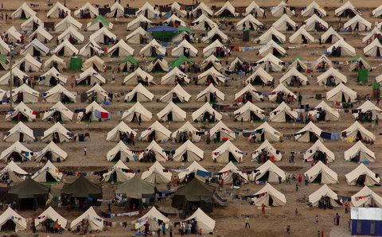
By the numbers
REFUGEES AND DISPLACED PERSONS GLOBALLY
100.000.000
COUNTRIES WITH DRC PRESENCE
40
EMPLOYEES
9,000
VOLUNTEERS
7,000
DKK 3,2 BILLION
EUR 430 MILLION
USD 512 MILLION
TURNOVER

Slide 11
Trends affecting our impact
Climate Change
Principles under pressure
Conflict & Displacement
Humanitarian Financing Gap
Localisation
Covid-19
Digitalisation of Aid
Humanitarian-Development-Peace Nexus

Slide 12
Selected strategic pillars – to lift DRC Strategy 2025
Go Digital
Identifying and assisting digital employment entry points and pilot initiatives, ultimately bridging the digital divide
Go Green
Searching for solutions to climate change as a driver and multiplier of displacement by piloting and scaling long-term sustainable solutions in the field and becoming nature-positive as an organisation
Partnerships & Alliances Further strengthening private sector partnerships and alliances to create and implement new solutions across markets and needs (global fundraising)
DRC
Strategy 2025
Increased Protection
Enhanced inclusion

Slide 13
DRC strengths in cross-sector partnerships
Globally present
Offering an organizational setup with considerable global knowledge and deep sector specific expertise, DRC is well positioned to pursue and add value in partnerships with businesses.
Locally present
Being directly present in more than 40 countries gives DRC a unique understanding of local needs and demands. This makes DRC an attractive partner to many businesses that are currently expanding their presence in local marketplaces.
Gives access to unique markets
As a trusted partner among local communities and local municipal agents, along with DRC’s excellent reputation, a partnership with DRC grants access to unique markets in areas that are usually hard to get access to.
Possibility to scale solutions
Without hurting the existing operations, DRC can help with expanding the partner-organization while also improving its efficiency and output.
Testing products and services
DRC enables partners to test their products and services in a safe and competent environment.

Slide 14
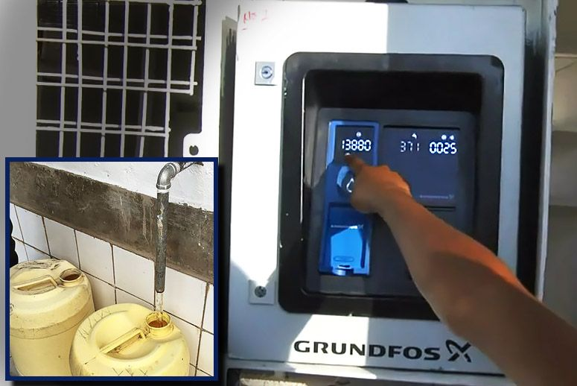
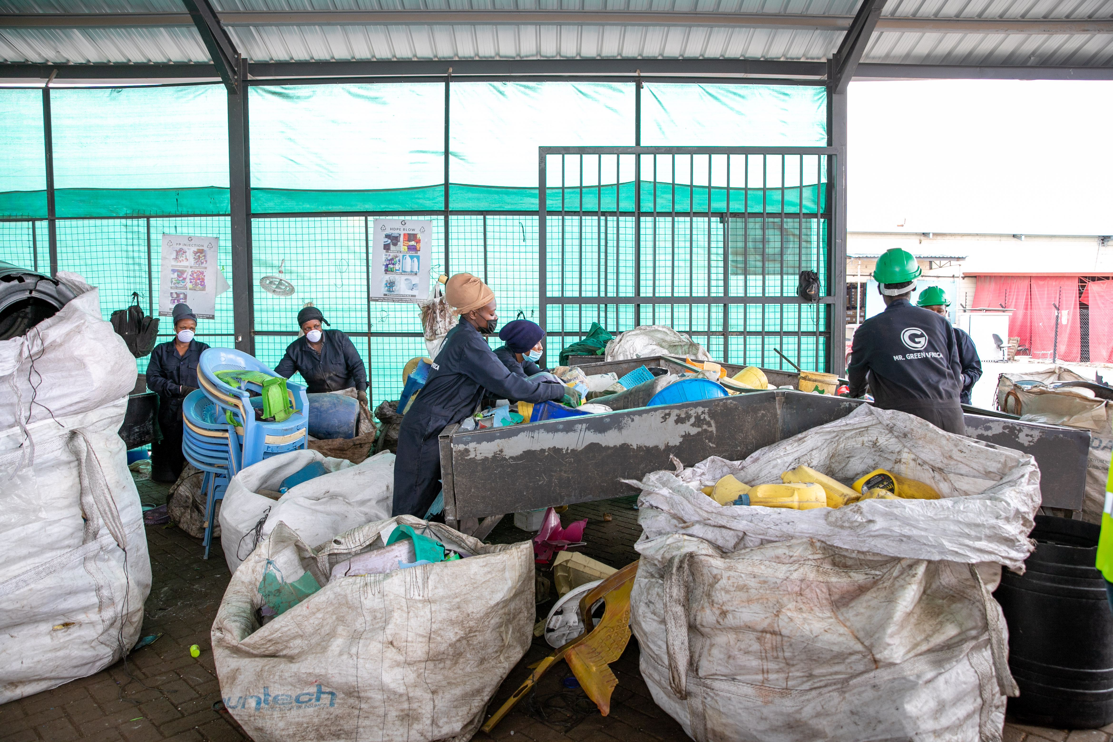
Partnership Cases
Partnership Case: Mr. Green Africa x Unilever x DRC
Fair Recycling: Recycling and employment
Africa contains some of the world’s largest amounts of plastic waste as well as an increasing refugee and displacement crises. DRC is working on the Fair Recycling Project to provide more jobs, higher income and better work conditions for refugees. In Partnership with Mr. Green Africa, refugees are enrolled in employment programs as waste-pickers . Unilever buy-up the gathered plastic, which is recycled in new consumer products, contributing to a fair and formal recycling ecosystem in Kenya
Partnership Case: Grundfos x DRC Build-Operate-Transfer: Solar-powered water systems
Uganda is among the top refugee-hosting countries in the world. Here, the Danish Refugee Council and Grundfos cooperates in delivering better and more sustainable, solar powered water provision systems to refugees and host communities. It is a significantly cheaper, more sustainable and more climate-friendly approach than delivering water using tank trucks as we previously did

Slide 15
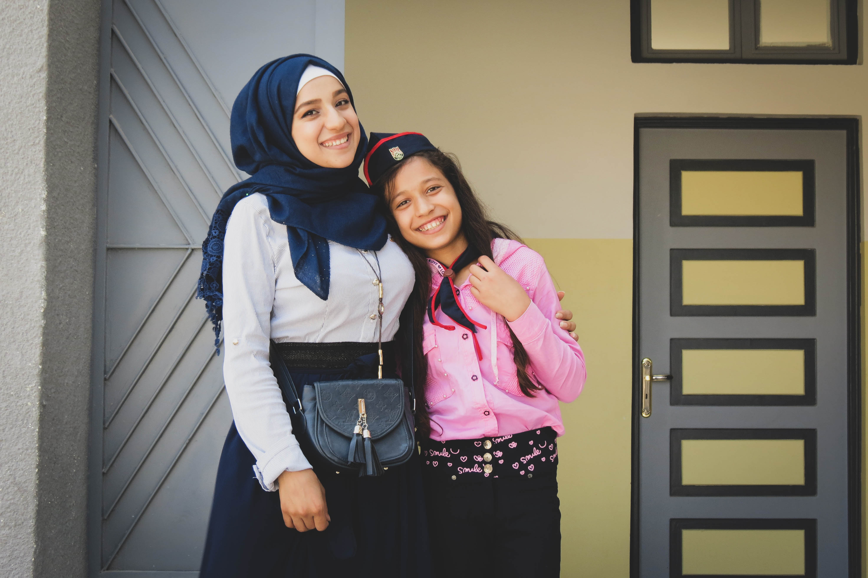
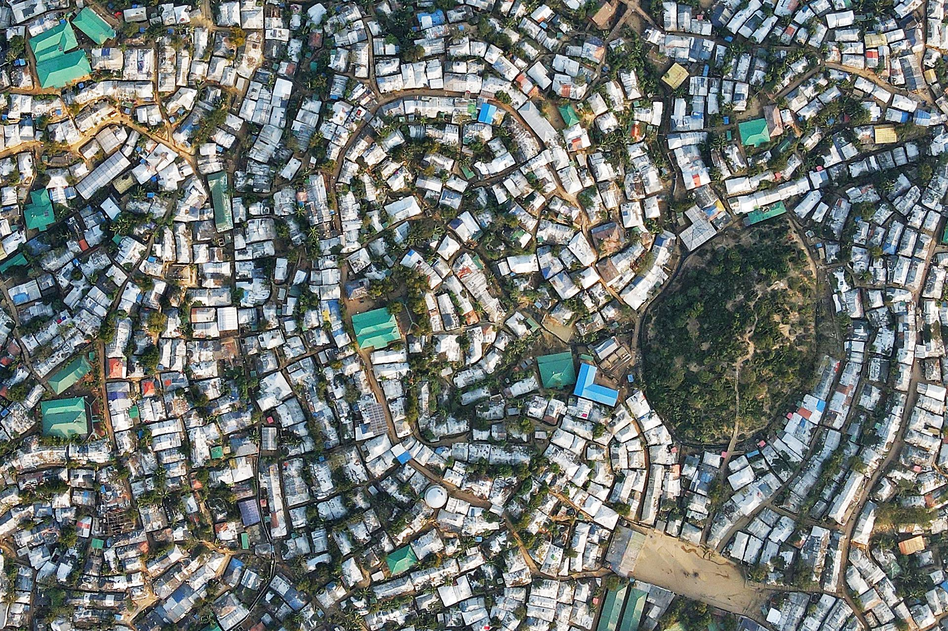
Partnership Cases
Partnership Case: IMB x DRC
Foresight: Big data predictability tool
With support from IBM and the Danish Ministry of Foreign Affairs, the Danish Refugee Council has developed Foresight - an innovative, analytical software. Through predictive analyses of factors such as economy, conflict level, climate, governance and other data Foresight can forecast large-scale forced displacement allowing governments and humanitarian organizations to respond earlier and more efficiently.
Partnership Case: Novo Nordisk Foundation x DRC RYSE: Youth project for socially and economically empowerment
In Jordan, the Novo Nordisk Foundation supports RYSE, a project where the Danish Refugee Council and four partner organizations' are engaging 25,000+ young Syrian refugees and vulnerable young Jordanians in building resilient futures for themselves and their communities through access to education and support to positive transition into adulthood

Slide 16
Deep Dive: Climate and Environment To potentially involve and engage in as discussed in our meeting
DRCs Framework on Climate Change and Environment – core pillars
Ideas for areas to explore
Reduction of carbon footprint:
Carbon credit and carbon capture
Pilot project underway in Uganda on how to become part of carbon credit markets
Supply chain (scope 3) carbon accounting
Regenerative and bio circular economy: Burundi case for interest (Video: Restoring the Colline) – is working on scaling regenerative practices under DANIDA strategic partnership agreement
Development of sustainable products and services within the core sectors and supply chain: Shelter, camp management, emergency kits etc.
New innovative climate finance models explore. DRC is exploring designs on a DRC Climate Fund (leads: global innovative finance team and climate advisor). Sparring on the set up and themes (topics of interest: clean energy for refugees, desertification and water management in agriculture in Iraq, decarbonisation initiatives)
Next step: Lillah and Luvisa to connect
Learn more
DRC’s Framework on Climate Change and Environment
Advocacy
and addressing the climate related protection needs
Climate adaptation
In programmatic response
Mitigation
to reduce DRC’s environmental and climate footprint
Learn more
DRC’s Climate and Environmental Performance Report 2021

Slide 17
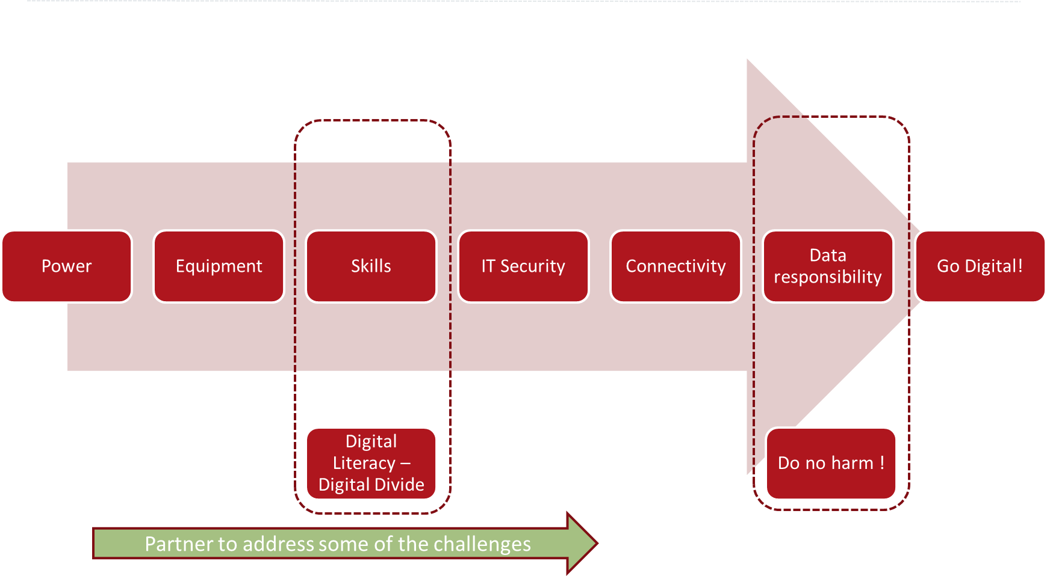
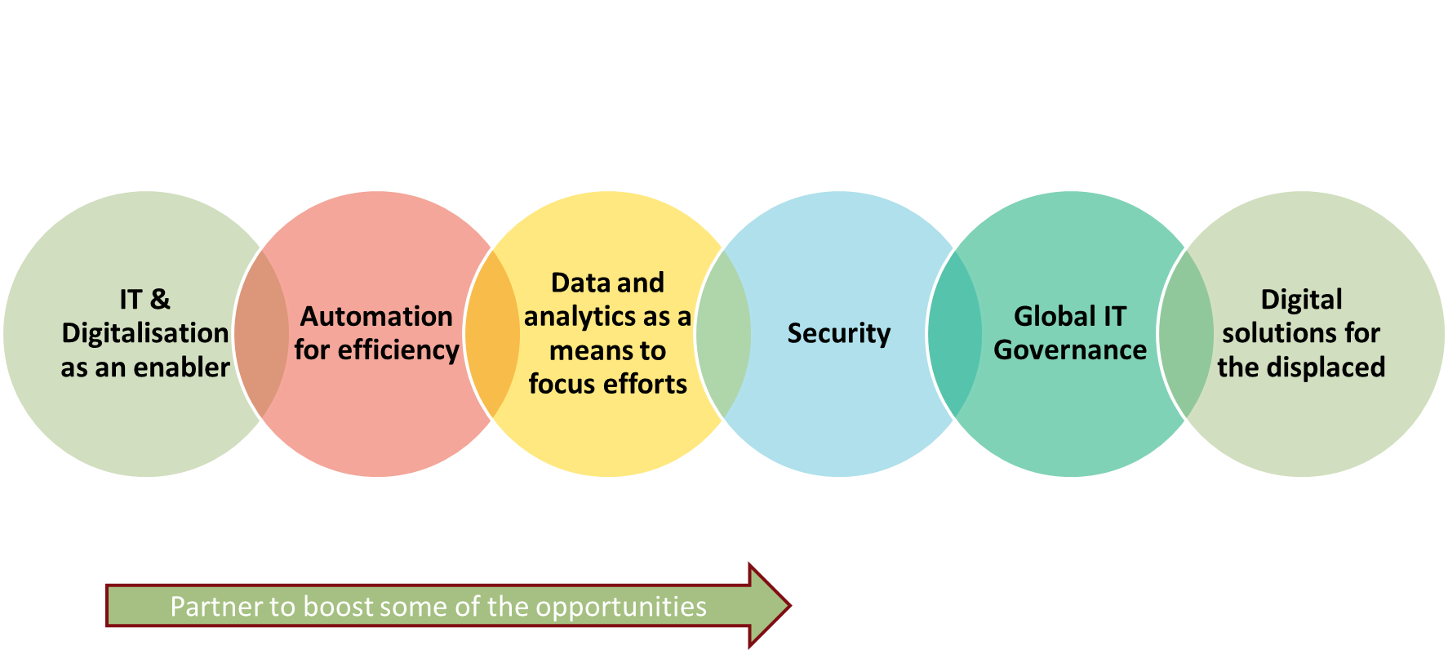
Deep Dive: Digitalization
To potentially involve and engage in as discussed in our meeting
Continue the dialogue on
Digitalisation: With its new Strategy 2025, DRC is committed to ‘increase its ability to cultivate digital opportunities in high-quality interventions that add value for displaced communities.’ We would like to discuss advice on
Addressing both the challenges and opportunities
Design of simple tools and guides to (i) improve digital literacy and (ii) design digital programmes in humanitarian response
Predictive Analytics/foresight as transformative tool
Next step: continue dialogue, Nana to introduce IT (Go digital lead) Steffen Kølbek and Claire Kjær. Decide whether we want to sub-stream this work with own anchor points for the exploration and possible collaboration.

Slide 18
Deep Dive: ‘Other operating’ practices
>Innovation, >Business Engagement and >Private Fundraising
Continue the dialogue on
Business Engagement & value proposition: DRCs Business engagement focuses on i) Protection (core sector), ii) Sustainability/ Green decent jobs for displacement affected, iii) Digital Employment
Advice and better market understanding to help position DRC for better and more strategic private sector engagement
Innovation Toolkit: DRC Programme Innovation Unit has designed various ideation tools in the course of the past 3,5 years.
Advice and design (graphical) support on tools development
Private Fundraising: Network and capacity across Accenture markets, focusing on Germany, Italy, UK and potentially US
Next step: continue dialogue, Julie, Nana and introduce Anders Günzel-Jensen (Private Sector lead) and Kasper Viebke (Head of Global Private Engagement). Decide whether we want to sub-stream these different work streams with individual anchor points for the exploration and collaboration.

