Slide 1
Mapping and convening – Improving ecosystem data management
What we have done so far
Fin-tech mapping - Private Sector Actors (PSA) operating in the Digital Financial services space in the Uganda refugee response
Agri-tech mapping - Private Sector Actors operating in the agriculture space in the Uganda refugee response
Settlement Level Actor Mapping (SLAM) – Mapping of actors operating in refugee settlements, and Kampala to promote localisation
Uganda Skilling Exchange (USE) – platform to centrally share training and skill-building opportunities for refugees and host community participants and for the participants to easily find and enrol in training and skill-building programs

Slide 2
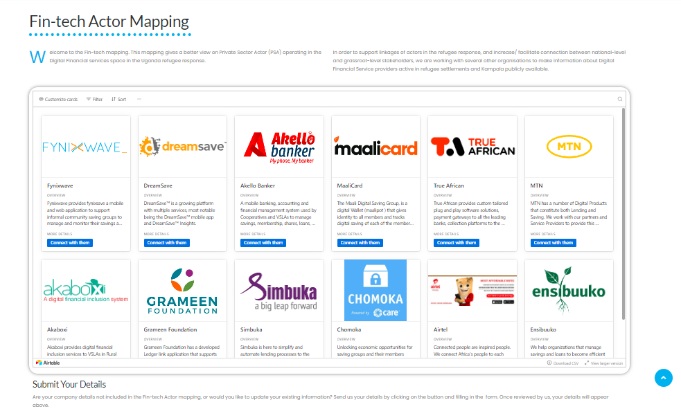

Slide 3
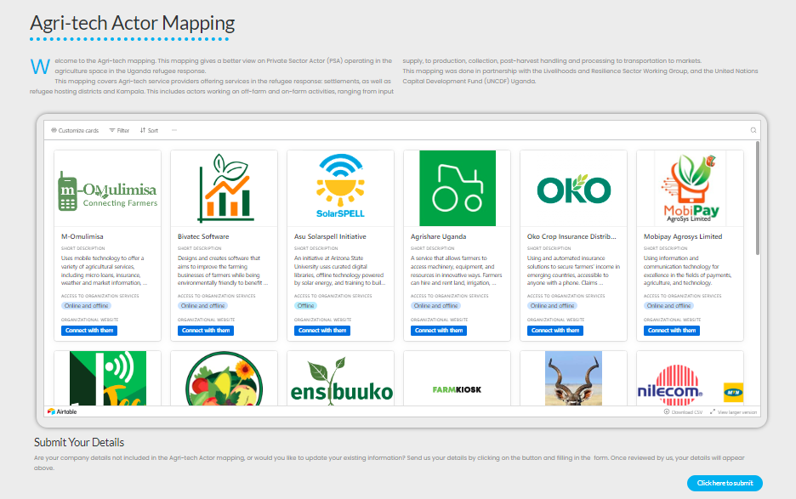

Slide 4
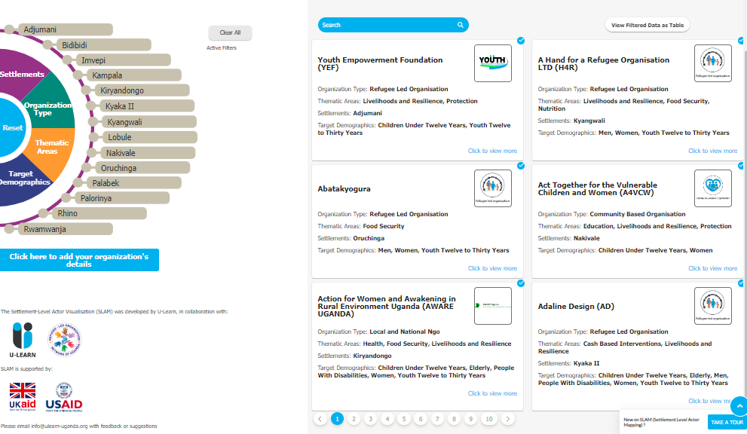
SLAM – Settlement Level Actor Mapping

Slide 5
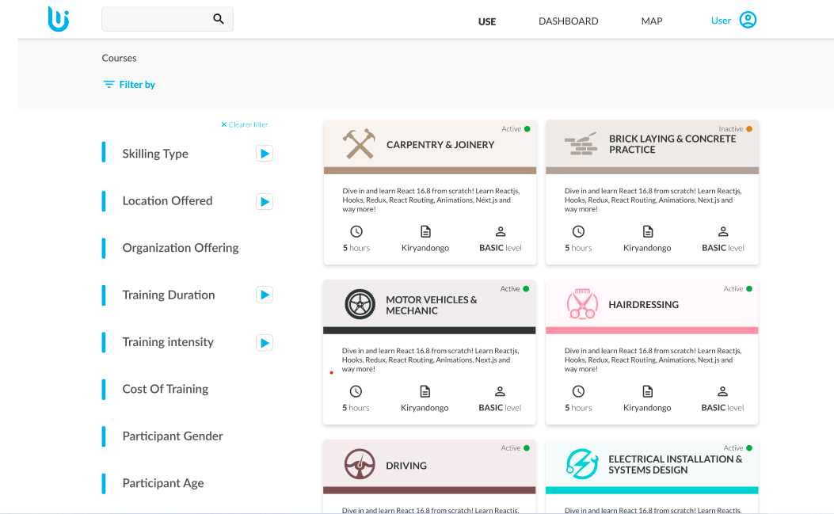
USE – Uganda Skilling Exchange

Slide 6
What we are doing next
SLAM – Transition to Charter for Change Working Group Uganda – Annual verifications, member trainings, etc.
USE: Phase one: making the information available, and phase two – registration, certification, tracking etc.
Climate actor Mapping - build knowledge, capacity, and understanding of the Ugandan Climate Change Action context and Climate Adaptive
Access all mappings here - https://ulearn-uganda.org/actor-mapping/

